Slide 1
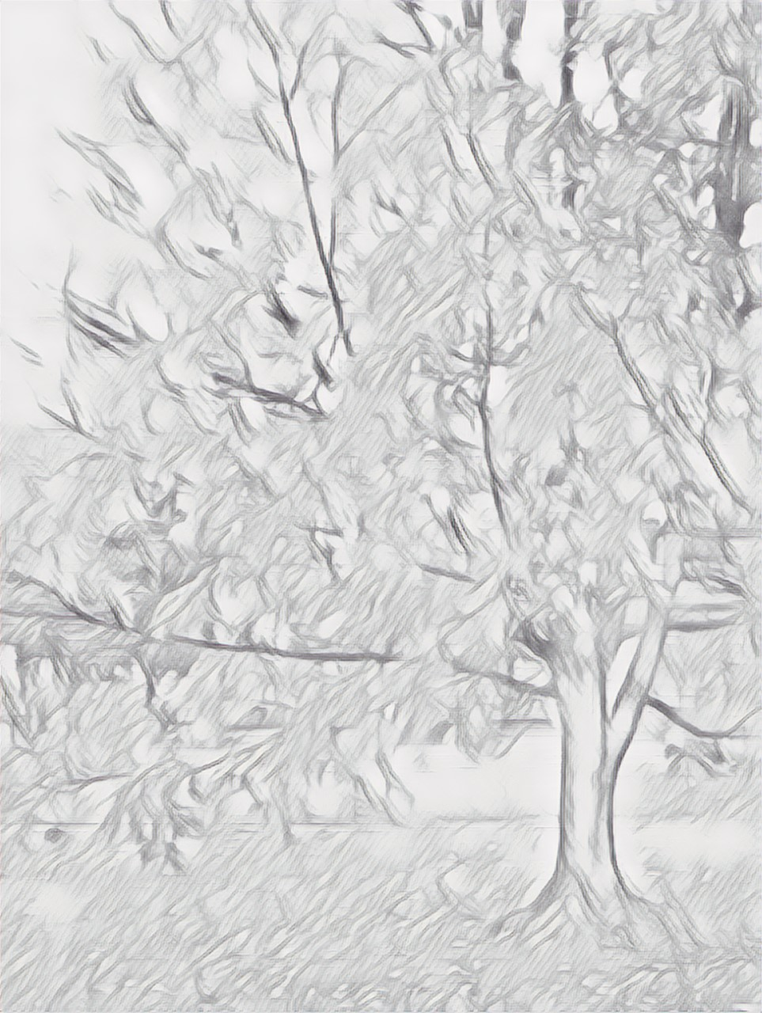
Portraits of a Life
Teresa Davidson

Slide 2
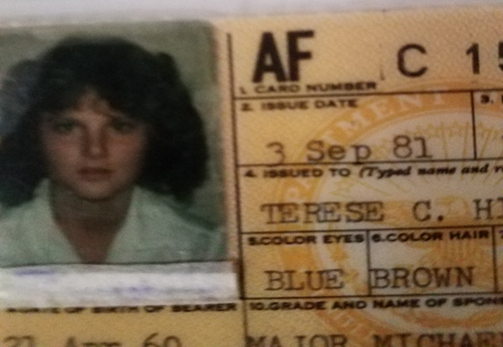
A short version of my story using pictures.
Here's me at 21. An extreme extrovert so full of too much to say!

Slide 3
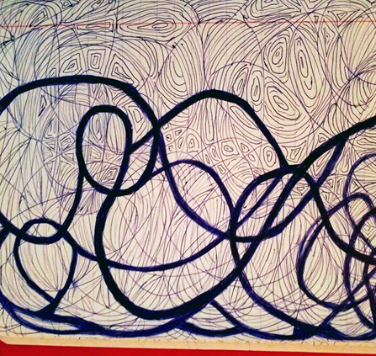
Always strong-willed, there were many incredible twists and turns.
With the good or the bad - I still strongly felt the world was full of possibilities - and life was mine.

Slide 4
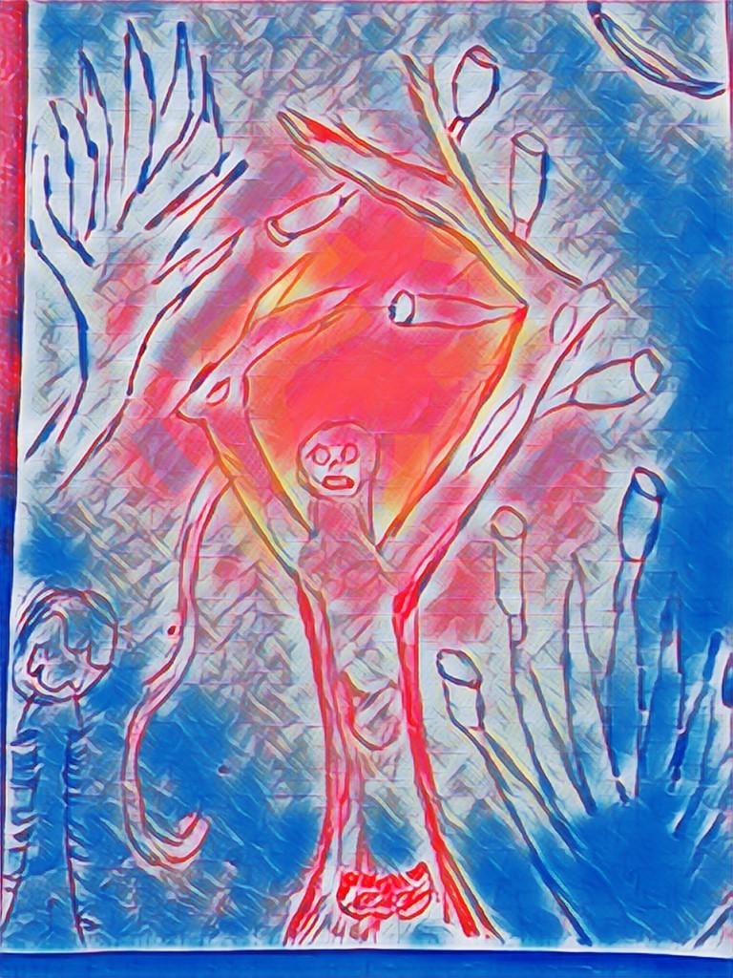
Around summer of 2005, when I was in mid-40s, the Scary Monster of Neurological Lyme became like a Nightmare in a strange movie!
I began using my Art as a way to express myself.

Slide 5

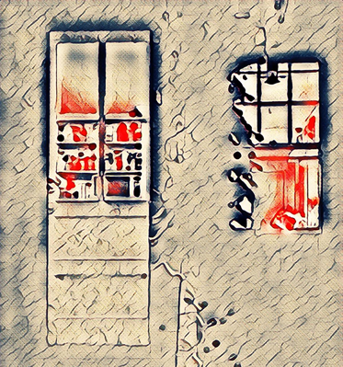
Communicating with
others began to feel like
a door that no longer opened
-something inside me was “off the mark”.
I was different.

Slide 6
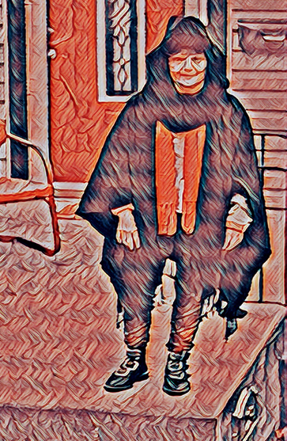
The boots, wool cape and winter hat were given to me by a friend before she moved back to Serbia.
In Eastern Cultures, Red stands for strength and courage. I needed to embrace the red inside myself.

Slide 7
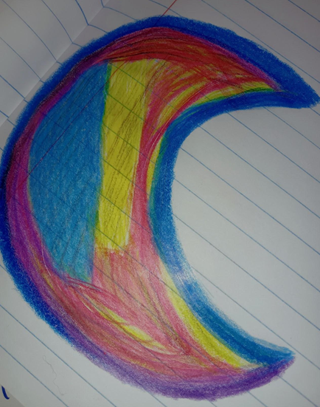
While listening to a Creative Writing Club discussion, I drew this vibrant moon, full of red.
The Chinese character for the Moon symbolizes Enlightenment. I feel privileged in having the opportunity to listen to the ideas and thought-processing of this group.
Thank you to ALL!!!

